Slide 1

Slide 1
Performance Analysis
2010 and 2011 under review

Slide 2
Pre processing
Deleted rows with a price of 0.
Negative quantities accepted, as they were considered as refunds.

Slide 3
RESEARCH QUESTIONS
Which products performed well and worse in terms of sales?
Is there any seasonality involved with sales?
Which countries performed best?
Which customers provide the most revenue?

Slide 4
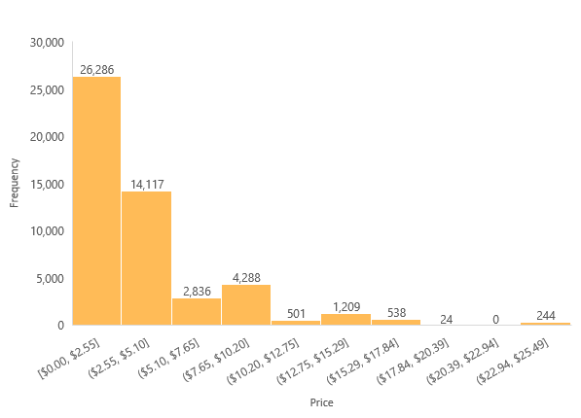
Price points
It can be observed that most price points fall between $0 and $2.55, with a value 26,286, followed by $2.56 to $5.10, with a value of 14,117.
When trying to optimize for most sold items, these two could be the targets.

Slide 5
TOP PERFORMING PRODUCTS
Over the whole period in analysis, between the fourth quarter of 2010 and the fourth quarter of 2011, we find that the most sold gifts were the Lunch Bag Red Retrospot ($35,893.31), followed by the Set of 3 Regency Cake Tins ($30,756.45).
Jumbo Shopper Vintage Red Paisley, Roses Regency Teacup and Saucer and Doormat Red Retrospot were the three following best performing products over the duration.

Slide 6
bOTTOM PERFORMING PRODUCTS
The worst performing product over the period was the Toothpaste Tube Pen ($776,75), followed by Travel Card Wallet Pantry ($829.66) and the Card Party Games ($893.51).
These three were followed by the Pack of 12 Spaceboy Tissues and the Rainy Ladies Birthday card.
The E-commerce shop could contemplate discontinuing these.

Slide 7
Performance over time
In this chart, we can see the evolution of the revenue along the months.
In 2011, from which we have the most datapoints, we can see an overall increasing trend, registering only four decreasing months, in April, August, October and December.
Furthermore, looking at December, we find that compared to 2010, there was a big decrease in revenue, from $80,093 to $38,535 in 2011.
These data points seem to indicate seasonality, as there are big increases from the month of April to June and September to November.

Slide 8
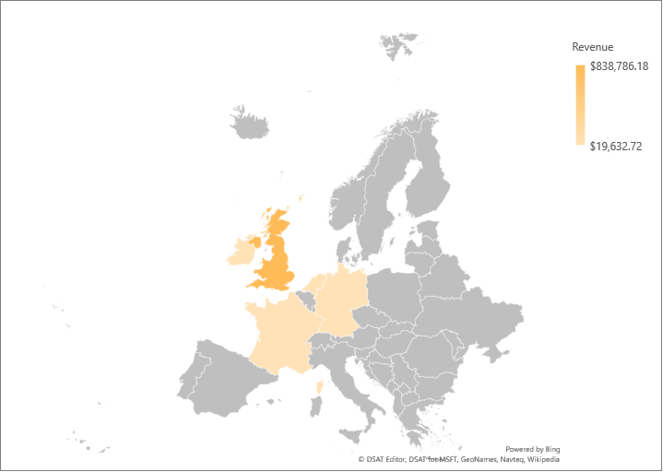
Top performing countries
In this heatmap, we can visualize the countries that contributed most to the revenue of the E-commerce Website.
The United Kingdom was the top country in this regard, amassing a revenue of $838,786, 32 times the revenue of the second most revenue bringing country, Netherlands.
EIRE (Ireland), Germany and France were the three best contributors after those two.
Netherlands, Ireland, Germany and France are very close in revenue.
$25,866
Ireland
$838,786
United Kingdom
$25,866
Netherlands
$20,765
Germany
$19,633
France

Slide 9
Top performing countries
In this heatmap, we can visualize the countries that contributed most to the revenue of the E-commerce Website.
The United Kingdom was the top country in this regard, amassing a revenue of $838,786, 32 times the revenue of the second most revenue bringing country, Netherlands.
EIRE (Ireland), Germany and France were the three best contributors after those two.
Netherlands, Ireland, Germany and France are very close in revenue.
$25,866
Ireland
$838,786
United Kingdom
$25,866
Netherlands
$20,765
Germany
$19,633
France

Slide 10
Top performing customers
With this bar chart, we can see the top 10 contributing customers to the revenue.
The most revenue bringing customer was “18102”, with more than double the revenue of the second one.
A further analysis could be to include costs of customers and conclude if the customer would be profitable overtime (Customer Lifetime Value).
We can see that most of the revenue has no associated Customer ID, the sales with Customer Ids recorded could be due to a loyalty card, for example.

